Slide 1
Embeddings

Slide 2
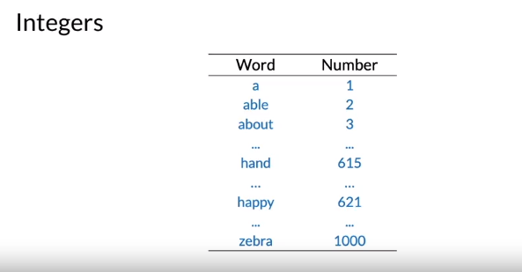

Slide 3
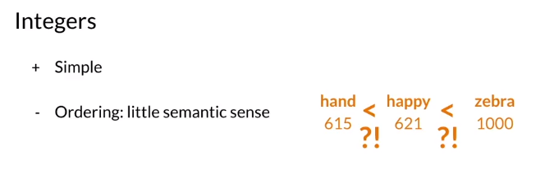

Slide 4
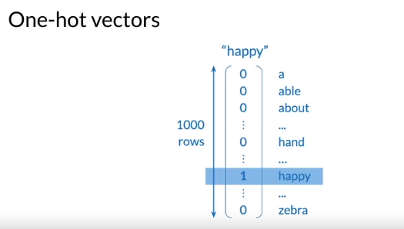

Slide 5
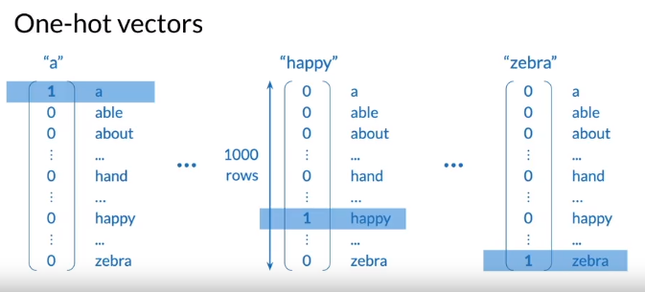

Slide 6
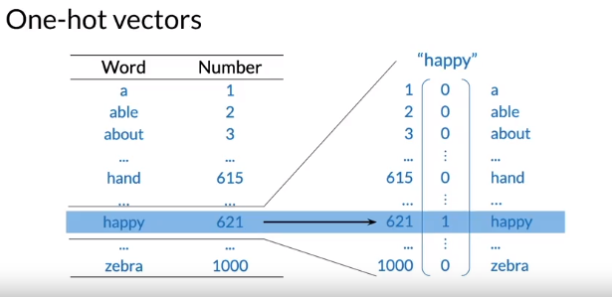

Slide 7
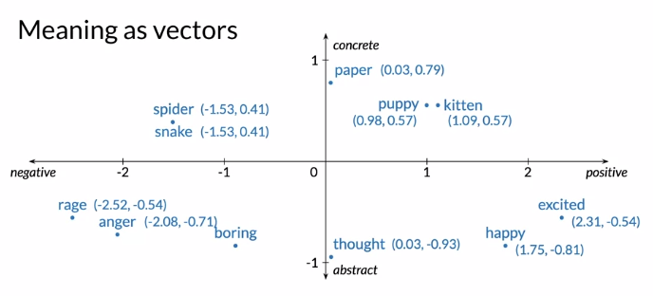
Word embeddings are vectors that’s carrying meaning with relatively low dimension

Slide 8
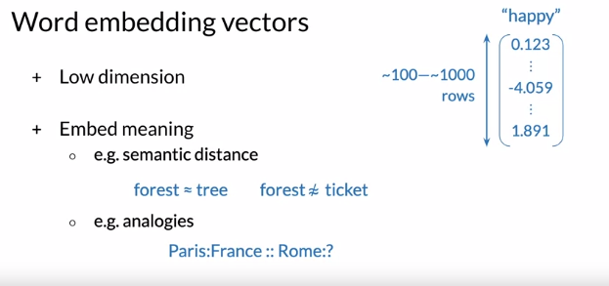

Slide 9
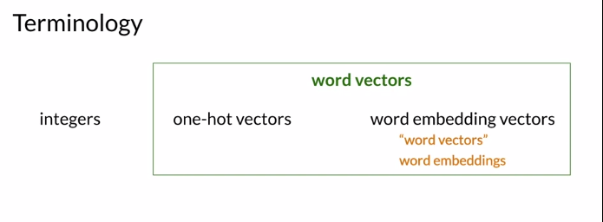

Slide 10
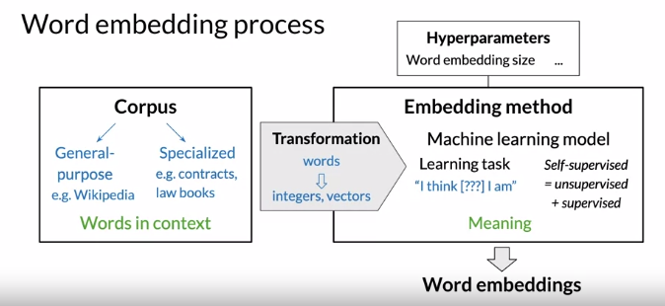
To create a word embeddings you need a corpus of text and an embedding method
Notes:
When creating word embeddings, the corpus you are using to create them will affect your word embeddings. This is something we will explore, but first let us see what is required to create these embeddings. To create word embeddings, you always need two things, a corpus of text, and an embedding method. The corpus contains the words you want to embed, organized in the same way as they would be used in the context of interest. For example, if you want to generate towards embeddings based on Shakespeare, then your corpus would be the full, and original text of Shakespeare and not study notes, side presentations, or keywords from Shakespeare. The context of a word refers to what other words or combination of words tend to occur around that particular word, the context is important as this is what will give meaning to each word embedding. A simple vocabulary list of Shakespeare's most common words, would not be enough to create embeddings. The corpus would be a general purpose sets of documents such as, Wikipedia articles, or it could be more specialist such as, an industry, or enterprise specific corpus to capture the nuances of the context. For NLP use cases on legal topics, you could use contracts, and law books as the corpus, the embedding method creates the word embeddings from the corpus. There are many types of possible methods, but in this course I will focus on modern methods based on machine learning models which are set to learn the word embeddings. The machine learning model performs a learning task, and the main by products of this task are the word embeddings. For instance, the task could be to learn to predict a word based on the surrounding words, any sentence of the corpus as in the case of the continuous bag of words approach that I will describe in the next videos that you will implement this week. The specific of the task, are what will ultimately define the meaning of the individual words. I'll get back to this in one of the next videos, the task is said to be self supervised. It is both unsupervised in the sense that the input data, the corpus is unlabeled, and supervised in the sense that the data itself provides the necessary context which would ordinarily make up the labels. So the corpus is a self contained data set that contains both the training data, and the data that enables the supervision of the task. Word embeddings can be tuned by a number of hyper parameters just like in any machine learning model. One of these hyper parameters is the dimension of the word embedding vectors. In practice, this dimension typically ranges from a few hundred to the low thousands. Using higher dimensions, captures more nuanced meanings, but is more computational expensive, both as training time, and later down the line when using the word embedding vectors, this eventually leads to diminishing returns. Finally, to feed the corpus into the machine learning model, the contents of the corpus must first be transformed into a suitable mathematical representation from words into numbers. The representation depends on the specifics of the model, but it is usually based on the simple representations that I presented in the previous video, such as integer base towards indices, or one hot vectors. You learned about high level process to create context embeddings. For the next step, I'll introduce you to several word embedding methods, including the continuous bag of words approach that you will be implementing in this week's assignment. So far, we have learned a new term known as self supervised learning, this term will show up again and again in the field of machine learning. It is a mix of unsupervised learning, and supervised learning. Now in the next video we will see some of the methods used for word embeddings.

Slide 11
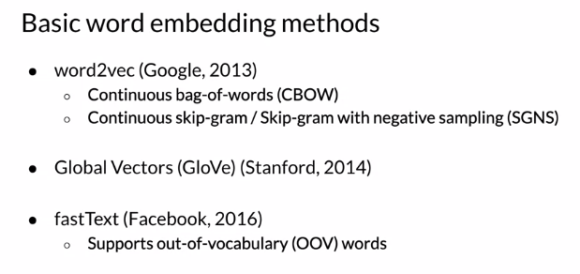

Slide 12
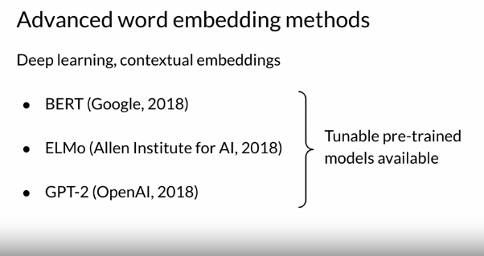

Slide 13
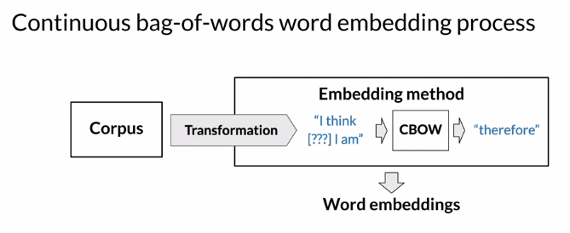
Notes:
You'll now see the overall structure of the algorithm you'll be implementing this week. You'll see how you can initialize your word vectors to predict new word vectors. Let's dive in and see how you can do this. I'll start with the overall process for machine learning model-based word embeddings, and then move on to how it's instantiated for the continuous bag-of-words model. As a reminder, to create word embeddings, you need a corpus, and a machine learning model that performs a learning task. One by-product of the learning task is a set of word embeddings. You also need a way to transform the corpus into a representation that is suited to the machine learning model

Slide 14
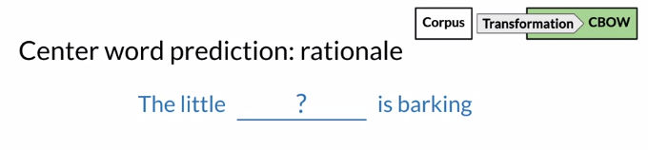
Notes:
. In the case of the continuous bag-of-words model, the objective of the task is to predict a missing word based on the surrounding words. The rationale is that if two unique words are both frequently surrounded by a similar sets of words when used in various sentences, then those two words tend to be related in their meaning. Another way to say this is that they are related semantically

Slide 15
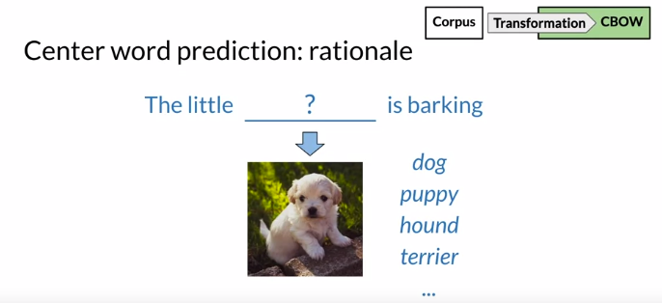
Notes:
. For example, in the sentence, the little something is barking, with a large enough corpus, the model will learn to predict that the missing word is related to dogs, such as the word dog itself, or puppy, hound, terrier, and so on.

Slide 16
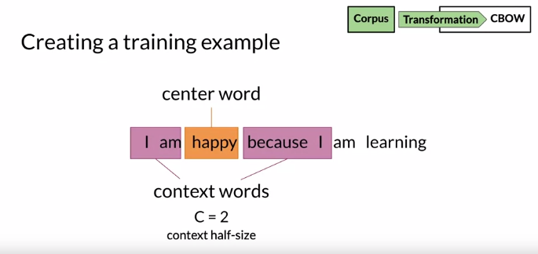
Notes:
The model will end up learning the meaning of words based on their contexts. How do you use the corpus to create training data for the prediction task? Let's say that the corpus is the sentence, I am happy because I'm learning, and you can ignore the punctuation for now. For a given word of a corpus, happy, for example, which I'll call the center word, I will define the context words as forwards, the two words before the center word, and the towards after it, and I'll note this as C equals 2, for the two words before or after. Where C is called the half size of the contexts, it is a hyperparameter of the model. You could use another number of words. This is just an example. Here, the context words for the center word happy are I am because I.

Slide 17
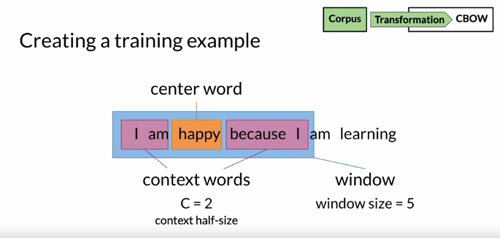
Notes:
Let's also define the window as the count of the center word plus the context words. Here, the size of the window is equal to one center word plus two context words before, plus two contexts words after, which equals to five.

Slide 18
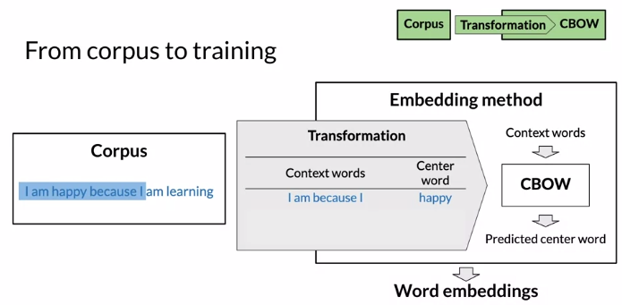
Notes:
To train the model, you will need a sets of examples, and each example will be made of context words and the center word to be predicted. In this first example, the window is, I am happy because I, and the model will take the context words I am because I, and should predict the center word, happy. You can now slide the window by one word, and the next training example that you have is, I'm happy something I am. The input to the model will be the context words, I'm happy I am, and the target center word, to predict is because. Sliding the window by one again, the model will take happy because I'm learning and should predict the target I. This is basically how the continuous bag-of-words model works. As you can see in the model architecture from the original paper, context words as inputs, and center words as outputs.

Slide 19
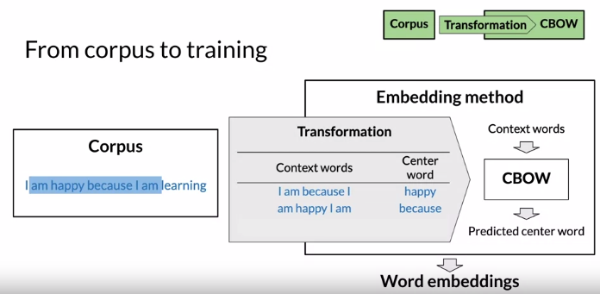

Slide 20
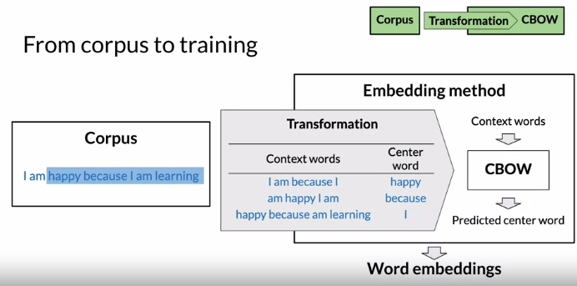

Slide 21
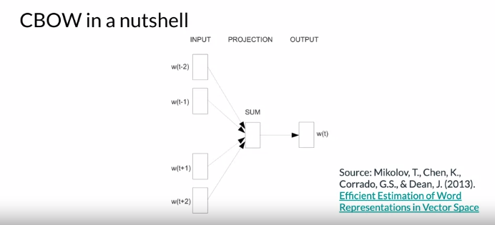
Notes:
To recap, you just learned how the continuous bag-of-words model broadly works. To recap, in a continuous bag-of-words model, you try to predict the center word using the context words or the surrounding words, and as a byproduct of the algorithm, you end up getting the word embeddings. In the next videos, we will show you how this actually works.

Slide 22
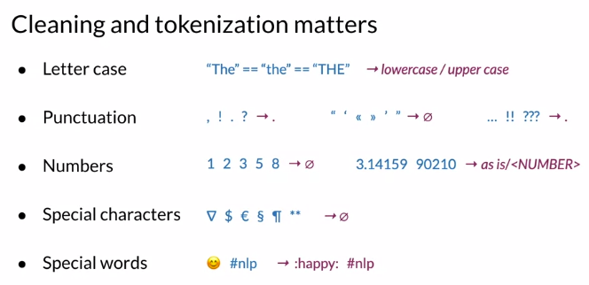
Notes:
We will now explore cleaning and tokenization. I previously spoke about data preparation, cleaning, and tokenization, but now I'll go into some more details. First, you should consider the words of your corpus as case insensitive. For instance, the word 'The' should be represented identically regardless of its case, for example, whether it begins with a capital T, say at the beginning of the sentence or not. You can do this by converting the corpus to either all lowercase or all uppercase. Secondly, you should handle punctuation. You could, for instance, represents all interrupting punctuation marks such as full stops, commas, and question marks as a single special word of the vocabulary. You could ignore non-interrupting punctuation marks such as quotation marks. You could collapse multi-sign marks such as triple question marks into a single mark and so on. Next, you want to handle numbers. For example, if numbers do not carry an important meaning in your use case, you could drop all of the numbers. However, numbers may have significant meaning that is relevant to your use case. For instance, 3.14 is the number for Pi, 90210 is the name of a television show and the area code for Beverly Hills, California. You can keep these numbers in your corpora as this. If your corpora has many unique numbers such as many area codes, you may find that it makes more sense to replace all the numbers with a special token such as &lt;NUMBER&gt;. This allows the model to know that the important thing is that it's a number instead of trying to distinguish between 90210 and other area codes or phone numbers. You also need to handle special characters such as mathematical symbols, currency symbols, section and paragraph signs, online markup signs, and so on. It's usually safe to drop them. Finally, and especially if you're working on modern corpus of user inputs such as tweets or consumer reviews, you should handle special words such as emojis and hashtags, #nlp, depending on if and how you want your model to confirm meanings to them

Slide 23
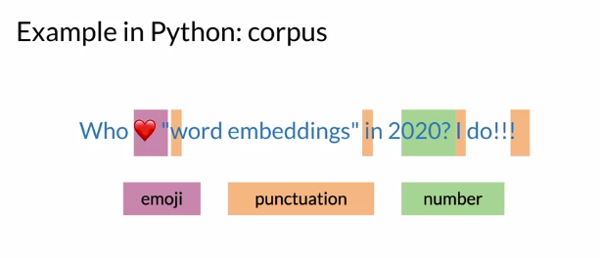

Slide 24
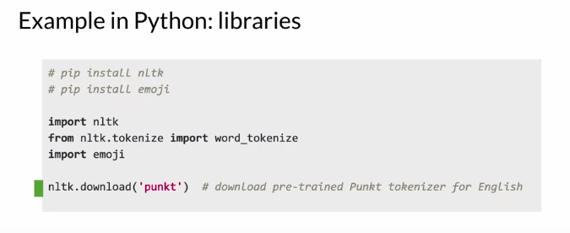

Slide 25
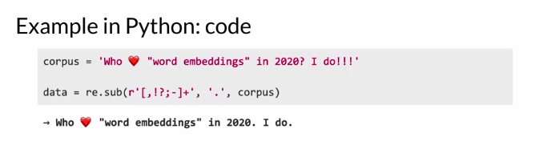

Slide 26
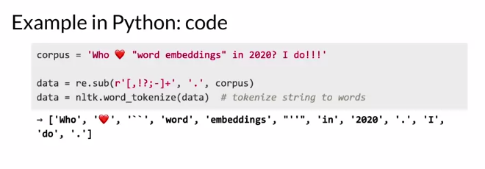

Slide 27
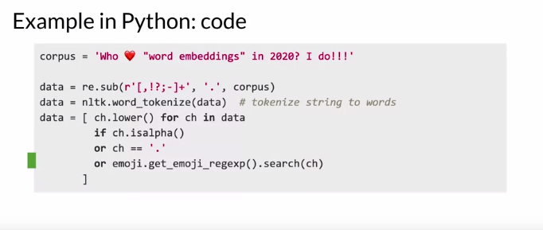

Slide 28
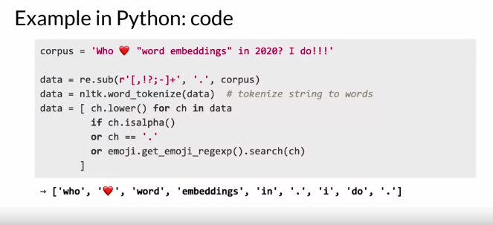

Slide 29
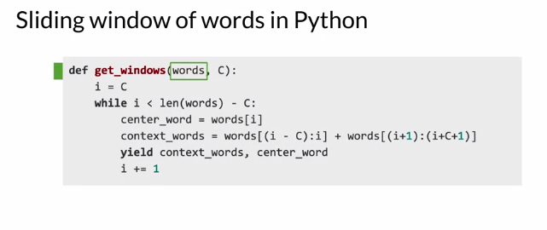

Slide 30
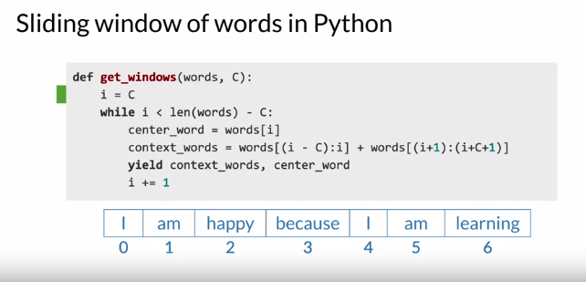

Slide 31
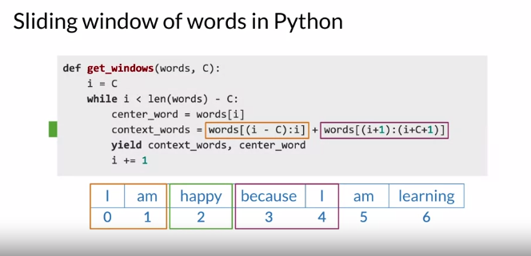

Slide 32
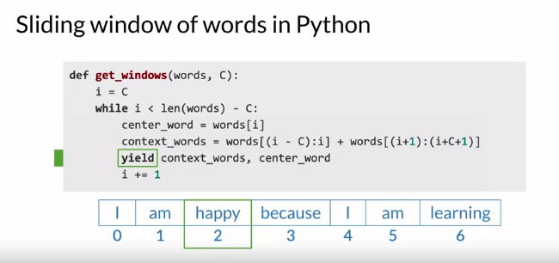

Slide 33
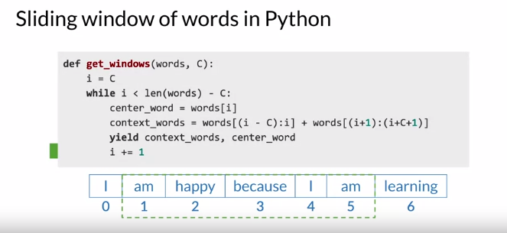

Slide 34
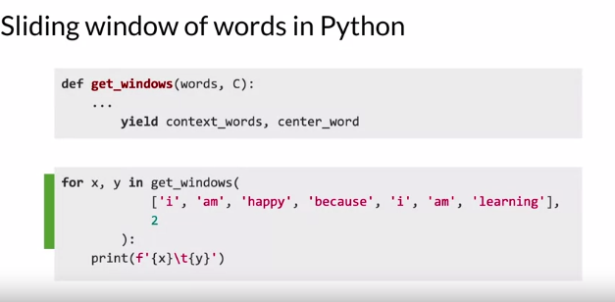

Slide 35
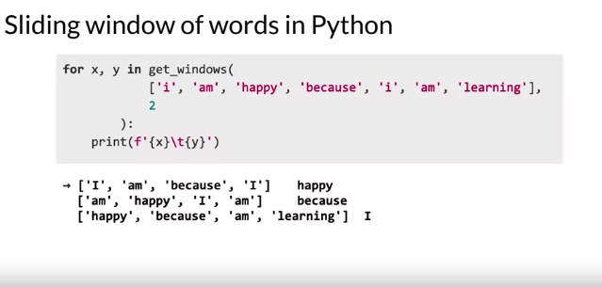

Slide 36
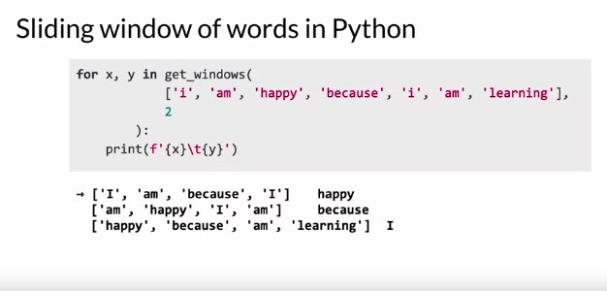

Slide 37
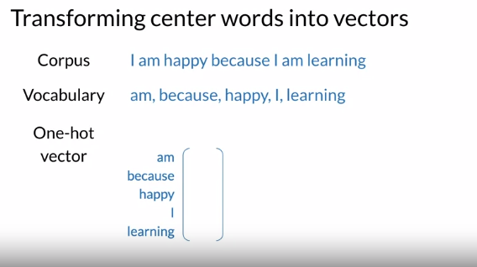

Slide 38
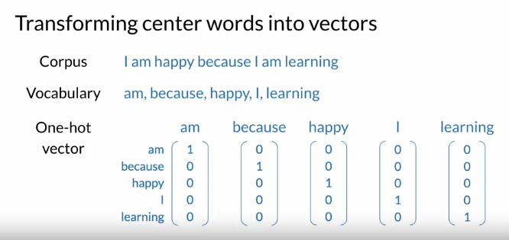

Slide 39
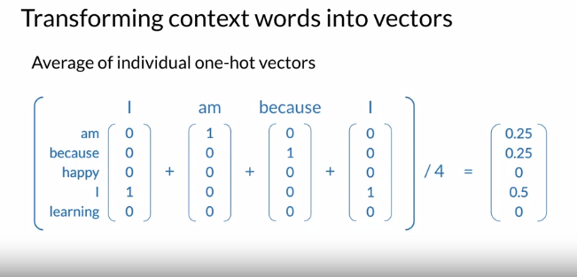

Slide 40
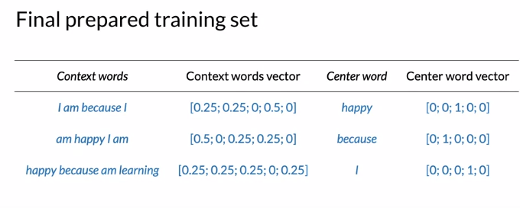

Slide 41
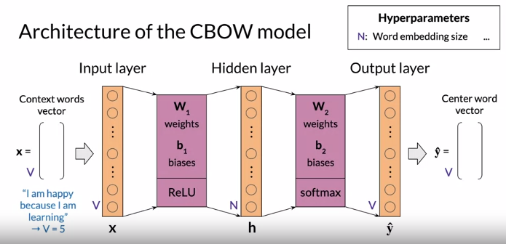
Notes:
I have been talking about the CBOW model for a while. Now, is finally the time to actually show you the architecture that is used to train this model. Without further ado, let's dive in. The continuous bag of words model is based on a shallow dense neural network with an input layer, a single hidden layer, and an output layer. As you remember, the inputs of the model is a vector of context words, which I'll call x, and the output is the vector of the predicted center word, which I'll call y hat. The size of these vectors is equal to the size of the vocabulary, which I'll call V. So the inputs and output size of this neural network is equal to V. For instance, if the corpus is, I am happy because I'm learning, you have a five-word vocabulary. So V equals 5 and you'll create a neural network where the input and output layers each have five neurons. In the real-world. corporal, this number will typically be in the thousands. Next is the hidden layer. If you remember from the lesson on the word embedding process, the size or dimension of the word embeddings is a hyperparameter of the model which you select yourself. Let's call the size of the word embedding capital N. Where capital N can typically be 100-1,000. You will choose the size of the hidden layer to equal the size of the expected word embedding. If you choose the size of the word embeddings to be N, then you will choose the hidden layer for this network to have N neurons, I'll call the vector representing the hidden layer h. This is irregular feed-forward network, also called a dense neural network, so the three layers are fully connected. I'll call the weights matrix between the input layer and hidden layer W_1, and the bias vector of the hidden layer is b_1. Similarly, W_2 is the weighting matrix between the hidden layer and the output layer and b_2 is the bias vector of the output layer. These are the matrices and vectors that the neural network will be learning as you train it. To give you a little preview of where you are going, you will derive the word embeddings from the weights matrices of this neural network. You will see more about this later. . You now need activation functions for the hidden layer and output layer. The results of the activation of the hidden layer is what gets sent to the next layer, which in this case is the output layer. Similarly, the outcome of the activation of the output layer is what will be shown as the model's prediction. For the hidden layer, you will use the rectified linear units function or ReLu. For the output layer, you will use the softmax function. The activation functions themselves deserve a proper discussion, so I'll describe them in one of the next videos. There you have it, the architecture of the continuous bag of words model. Next up, I'll go through the dimensions of the matrices and vectors I mentioned. Another important component you'll need for completing this week's fun assignments. In this video, you have seen the overall structure of your algorithm. You're trying to predict the middle word given the words outside or the context words. However, you have V possible ways that you can predict. You cannot use a logistic regression in this case, because the logistic regression outputs two possibilities.

Slide 42
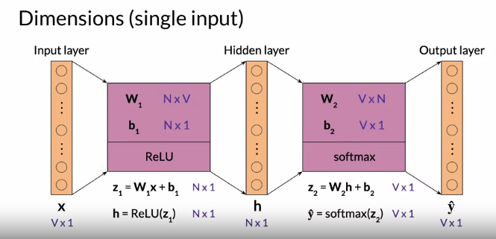

Slide 43
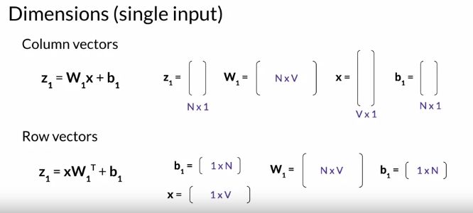
Notes:
If you have a situation where instead of column vectors you're working with row vectors, then you'll need to perform the calculations with transposed matrices, and inverted terms in the matrix multiplication. So for instance, instead of calculating h=W1x + b1, as you did with the column vectors, if x, and b1 are row vectors, then you would calculate xW1 transposed plus b1 to get z1, and then h, as a row vector. Next, I'll show you how to use the neural network with batches of several examples instead of just one example at a time. Now that you know the dimensions, this will help you in your programming assignments.

Slide 44
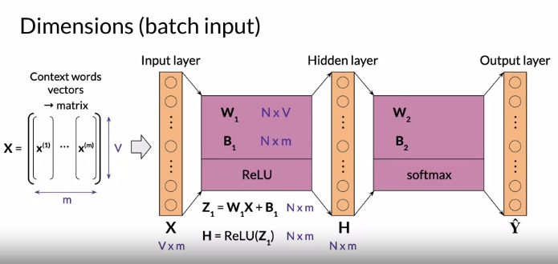
Notes:
We have mainly been speaking about the CBOW model by using one example as an input. However, what happens if we decide to feed in several inputs and get several outputs at the same time? How do we vectorized? &gt;&gt; By now you are familiar with the dimensions of the vectors and matrices used in the neural network for the continuous bag of words model when feeding in a single example. Instead of passing input vectors representing individual examples you may want to pass in several examples at a time. This usually makes the learning process quicker for a few reasons. For brevity, I won't get into them right now. Feeding several examples into the neural net at the same time is known as a batch processing and you're going to be doing it yourself in this week's assignment. Say that you want to feed an input context toward vectors into the neural network during each iteration. M is called the batch size and it's a hyper parameter of the model that you define at training time. You can join these m column vectors side by side to form a matrix with zero's and m columns, which I'll notice capital X. You can then pass this matrix through the network and you will get capital H. The matrix representing the values of the hidden layer equals ReLU the weight matrix capital Z1, where Z1 is W1 times X+B1. It's an N rows by m columns matrix. Know that you need to replace the original b1 bias vector with a bias matrix capital B1 where you duplicate the column vector M times to have an N by m matrix. So that the bias germs are added to each of the weighted sums just as a tip. When you're working on the assignment, this is known as broadcasting the vector to a matrix and it's performed automatically by numpy when adding a matrix to a column vector with the same number of rows. Next, capital Y hat, the matrix containing the m outputs. It is equal to the softmax of W2H+B2. And again you're replicating the bias vector lower case b2 M times to get the bias matrix capital B2. Y hat has zeros and m columns. You can break Y hat down into m column vectors, each one corresponding to one of the input context words vectors from the input matrix. So the vector from the first column of the input matrix is transformed into the vector corresponding to the first column of the output matrix, and similarly for the other m-1 vectors. Next, I'll introduce the activation functions used by the continuous bag of words model. You're getting closer to a working model. &gt;&gt; You are an expert in figuring out the dimensions of the CBOW model and can victories your inputs and outputs. This is really exciting stuff. In the next video, you'll take a deep dive into the activation functions used by this model

Slide 45
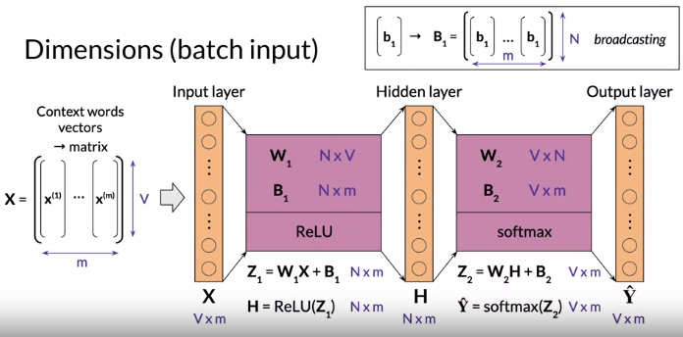

Slide 46
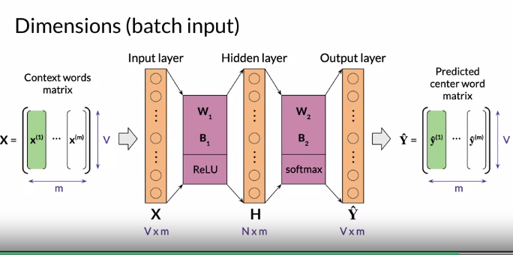

Slide 47
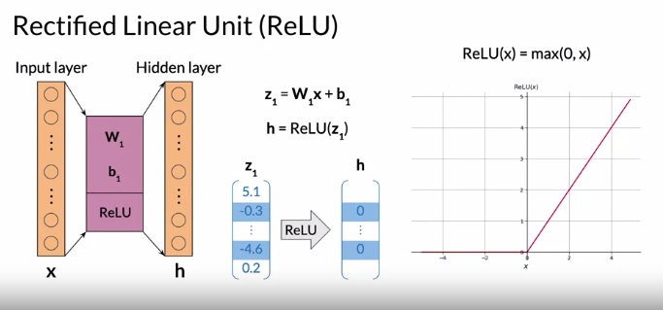
Notes:
Good to see you again. I'm about to explain arguably the two most important activation functions used in AI. The rectified linear unit also known as the railways and the softmax function. So let's get started. Before jumping into the softmax function. I want to talk a little bit about the ReLU function or rectified linear units. Apart from the input neurons which are used as is each layer first calculates the weighted sum of its inputs and adds a bias, then passes the results into an activation function. So for the hidden layer you first calculate Z1 equals W1 times X + B1. And to get H you pass Z1 into an activation function which is the rectified linear unit function ReLU for this layer. ReLU is a popular general purpose activation function that only activates the neuron every some of its weighted input is positive and passes through this result. If that's the case mathematically ReLU of X where X is a real number is equal to the maximum of 0 &amp; X. You can see the graph for this function here. Here's an example for vectors Z1 to get vector h representing the value of the hidden layer you apply the ReLU function. The rows from Z1 that's our negative like negative 0.3 and negative 4.6 become zeros in h. And the positive values stay as is so for instance 5.1 stays as 5.1 and 0.2 is still 0.2.

Slide 48
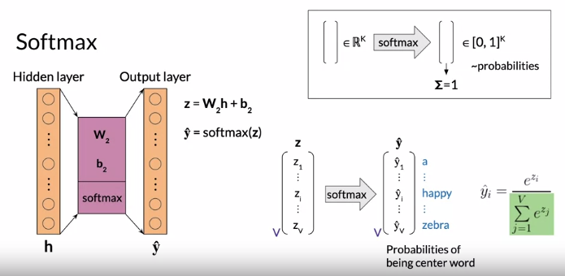
Notes:
Now, for the output layer you calculate the weighted sum of the values from the hidden layer. And add by it's vector that's W2h + b2 which I'll call Z instead of Z2 in the previous slides for reasons that will soon become apparent. You then passes Z into the activation function which is the softmax function for this layer. To get the output vector y hat. The softmax function works as follows. Its input is a vector of real numbers as opposed to ReLU which in its original form is a function of a single real number. It outputs a vector of real numbers in the interval 0-1 which some up to one and can be interpreted as probabilities of exclusive events. In the case of the continuous bag of words model. When you apply softmax to Z, you obtain an output vector Y hat with V rows where each row corresponds to a word of the vocabulary of the corpus. The values of the vector can be interpreted as the probability that the central word, which is what the models trying to predict is the word that is assigned to each of the rows. Mathematically if the input to softmax is vector Zi with element Ci with i ranging from one to V. And the resulting vector is Y hat with elements Y hats of i then Y hat i equals E to the Zi divided by the sum over J of E to the ZJ. The exponential transforms all our inputs to positive numbers and the divisor normalizes the vector so that their roles some up to one.

Slide 49
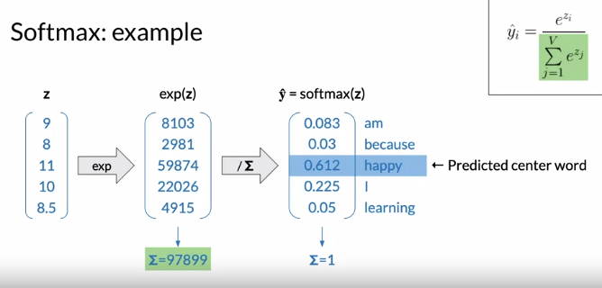
Notes:
To illustrate softmax with a numerical example, let's say that Z is equal to this vector taking the exponential of these values gives you this vector and the rows some up to 97899 which will be the denominator in the softmax function. You can now get the values of the we had vector by dividing the previous vector by the sum of its elements. So the first element will be 8103 divided by 97899 which is 0.083. And similarly for the other rows and the sum is of course equal to one. So mapping the rolls to the vocabulary, you would interpret this output vector as meaning that given a specific input context words vector X. The probability that the central world is M 0.083 for because the probability is 0.03 and so on. Now the highest value in the vector is 0.61 for the row corresponding to happy. So this would mean that the model is predicting that the central word is happy. You'll get to implement both revenue and softmax function in this week's assignment. So you have seen the two functions described the ReLU function changes all the negative numbers to zero and the softmax function allows you to get a vector of probabilities over k classes that tells you how likely an example is to belong to each class. Of course, the probabilities for each class have to sum up to one.

Slide 50
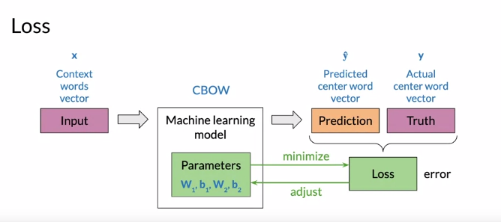
Notes:
I'll now show you the cost function for the Softmax. You'll understand why it is a cost function and you'll see why you are learning it. You basically have to predict one of the possible words. In order for you to be able to predict one of these V possible words, you need to minimize a certain cost function. In this video, you'll understand what cost function you are minimizing and while you're doing that, so let's take a look. Consider a machine learning model. A single training example made of an input and a true target and the value predicted by the model based on the input. It has a loss function which measures the air between the prediction and the true value for a single input training example with the continuous bag of words model for a set of input context words represented by vector X. For which the actual value is the vector Y that represents the actual central word. The prediction is the vector white hat. The objective of the learning process is to find the parameters that minimize the loss given the training data set. In the case of the continuous bag of words model, the parameters being adjusted by the learning process are the waiting matrices, W1 and W2 and also the bias factors B1 and B2.

Slide 51
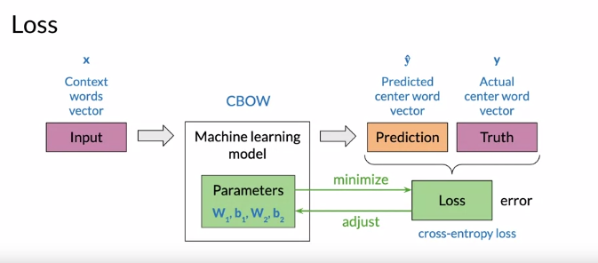
Notes:
The last function you'll be using is the cross entropy loss. I won't get into the theory. You should just know that the cross entropy loss function is often used with classification models which often go hand in hand with the softmax output player in your own networks just like the one you're using in the continuous bag of words model. If you've already worked with logistic regression, you probably already know a simple form of the cross entropy loss function, AKA log loss. When there are just two classes with the notation I used for the continuous bag of words model.

Slide 52

Notes:
The formula for cross entropy loss for a training example is J equals the negative of the sum over K from one to V P of Y K times the log of Y hat K, as an example, consider the input context towards I am because I were the actual central word is happy. The corresponding vector is this vector Y with A1 in the royal correspondence with you weren't happy. The prediction could be this vector Y hat as the largest value is in the Euro corresponding to the word happy.

Slide 53

Notes:
This vector would be interpreted as predicting happy as the central word which is the correct prediction in this case. So let's calculate the cross entropy loss.

Slide 54

Notes:
The log of Y hat is this vector multiplying each element by the corresponding element of Y gives us this vector and I'm using the circle dot to the note element Ys multiplication.

Slide 55

Notes:
No, there's only one non zero value which is negative 0.49. The sum is therefore this value and the loss is minus the sum, so 0.49.

Slide 56

Notes:
Now, what if the prediction was wrong? Say that the predicted vector was 0.96, 0.01, 0.01, 0.01 predicting am Instead of happy, the log would be this factor multiplying element twice by Y would give us this vector. Then the sum is negative 4.61 and the loss is negative 1 times this. So positive 4.61.

Slide 57

Notes:
So you can see that the losses larger when the prediction is incorrect, more generally the cross entropy loss boils down to negative one times the log of the value of the prediction element corresponding to the actual center word.

Slide 58

Notes:
So if you plot the cross entropy loss as a function of the value of the prediction for the actual central word, you can see that if the model is predicting correctly with a Y hat value closer to 1, then your loss will be closer to zero. This is because log of 1 is equal to zero. If on the other hand, the model is predicting incorrectly, then the Y hat for the actual word will be closer to zero, resulting in a high lost value.

Slide 59

Notes:
The reason for this is that the limits of log X as X approaches zero is minus infinity. So for the loss which uses negative 1 times the log as Y hat approaches zero. The loss approaches positive infinity. So the loss is rewarding correct predictions and penalizing incorrect predictions. You have computed the cross entropy loss for one training example, and have seen the plots of the cross entropy loss versus the actual prediction

Slide 60


Slide 61


Slide 62


Slide 63


Slide 64


Slide 65


Slide 66


Slide 67


Slide 68


Slide 69


Slide 70


Slide 71


Slide 72


Slide 73


Slide 74


Slide 75


Slide 76


Slide 77


Slide 78


Slide 79


Slide 80


